Slide 1
Rate-dependent adhesion and suction effects in contact modeling of poroelastic materials using finite element method Agnila Ghosh Surovi¹, Shank S. Kulkarni¹, Wonhyeok Lee², Melih Eriten², Timothy Truster¹ ¹University of Tennessee, Knoxville, Tennessee, USA ²University of Wisconsin-Madison, Madison, Wisconsin, USA
Presented By
Agnila Ghosh Surovi
Graduate Student
Mechanical, Biomedical and Aerospace Engineering
University of Tennessee, Knoxville
July 22, 2024

Slide 2
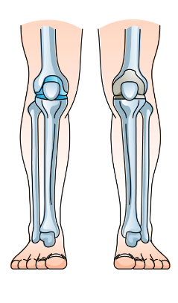
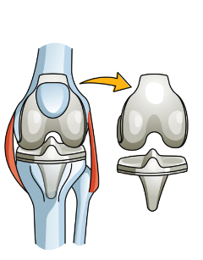
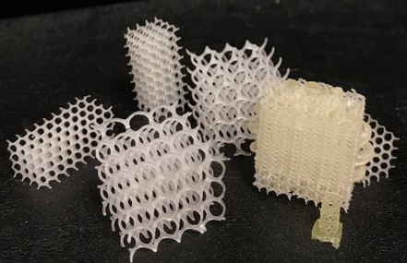
Motivation
Poroelastic materials can mimic the characteristics of soft biological tissues.
Extensive research has been conducted on the analysis of poroelastic contact behavior without considering their rate dependent adhesion behavior.
Nevertheless, to date, there remains no established computational framework capable of accurately describing the contact characteristics of poroelastic materials during retraction.
Total Knee Replacement
Scaffolds
https://drjeffpadaleckimd.com/cartilage-injuries-austin-texas/#
https://physicsworld.com/a/shape-memory-scaffolds-support-soft-tissue-healing/
Notes:
First and foremost, it is essential to understand the motivation behind this research.
Poroelastic materials can mimic the characteristics of soft biological tissues, making research on them significantly important in the biomedical and bioengineering fields."
Understanding the contact characteristics of poroelastic materials is crucial in applications where they interact with living body cells and hard tissues made of different materials, such as when used as scaffolds for tissue regeneration or in cartilage for total knee replacements.
Extensive research has been conducted on the analysis of poroelastic contact behavior, particularly through indentation studies. without considering their rate dependent adhesion behavior.
However, as of now, there is still no established computational framework capable of accurately describing the contact characteristics of poroelastic materials during retraction. This underscores our objective to fill this critical gap.

Slide 3
Content Layout
Background
Theory
Poroelastic Material Model
Contact Formulation
Adhesion based Contact Model
Numerical Setup
Results and Analysis
Validation of 3D Terzaghi’s Poroelastic Consolidation Problem
Analysis of Frictionless Contact between Poroelastic Material and Isotropic Linear Elastic Solid Material
Investigation of Adhesion Characteristics of Contact between Poroelastic Substrate and Isotropic Linear Elastic Solid Indenter
Conclusion
Notes:
Initially, I will review some previous work on poroelastic contact analysis from the literature. Following that, I will present related theoretical concepts. Then, I will share the results from our analysis. Finally, I will conclude with the outcomes of our research so far.

Slide 4
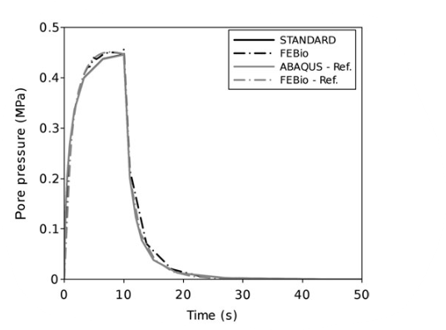
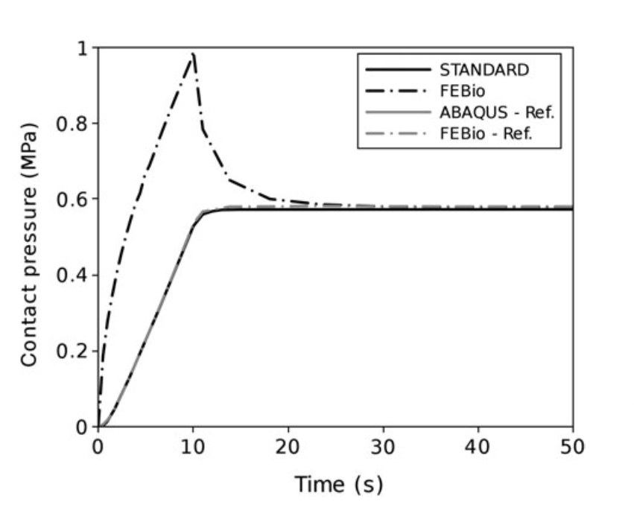
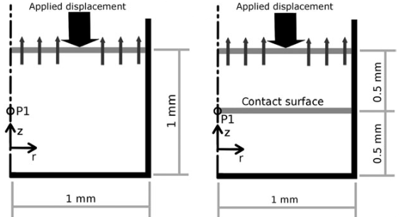
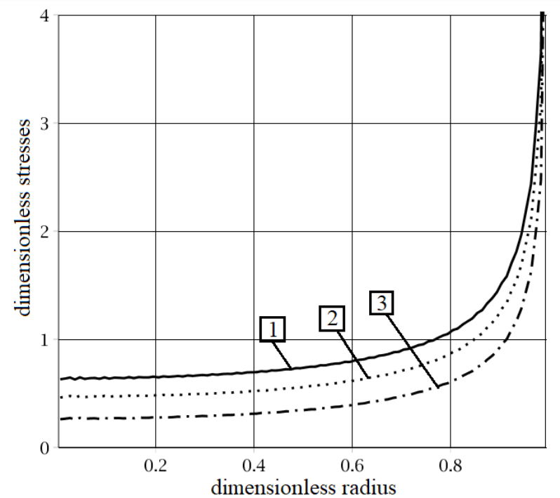
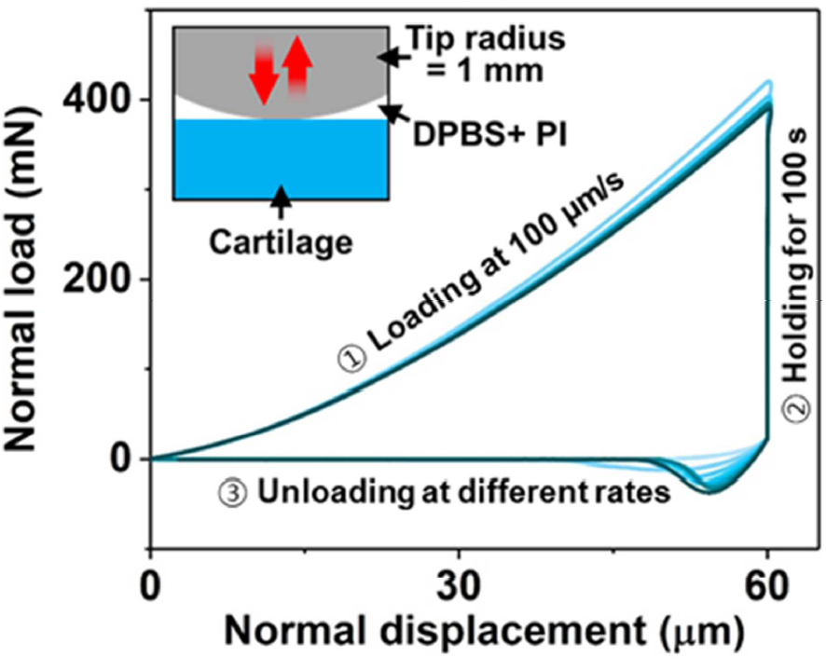
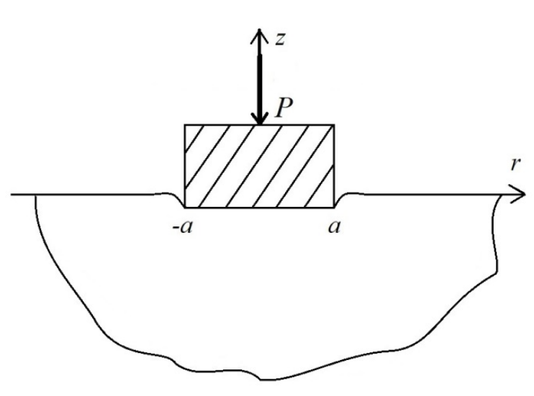
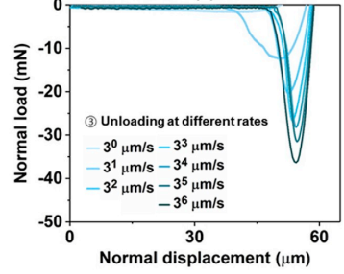
Background
Theory
Numerical Setup
Results and Analysis
Conclusion
Background
Existing Contact Methods
[Galbusera et al. (2012). Computer Methods in Biomechanics and Biomedical Engineering, 17(12), 1323–1334.]
Analytical Poroelastic Contact Model for Some Idealized Cases
Rate Dependent Adhesion Response
Chebakov et al. (2020). Materials physics and mechanics, 44(3), 423-432.
Han et al. (2020). Journal of the mechanical behavior of biomedical materials, 102, 103493.
Notes:
Now, let me show you some previous research related to our topic.
Top Image: At the top of the images, you can see….Galbusera et al. performed a comparative study on simulating frictionless contact between two saturated porous structures. They compared the capabilities of two finite element software programs: ABAQUS Standard and the open-source finite element code, FEBio. They found that both methods are capable, as evidenced by the pore pressure plot on the left, which shows similar results for both FEBio and ABAQus. However, the contact pressure plot is different beacuse ABAQUS calculates contact pressure based on effective stress instead of total stress.
Bottom Left Image: Chebakov et al. developed an analytical approach to frictionless contact between a saturated porous structure and a rigid structure. They used Hankel's integral transform to reduce the contact formulation to a solution of a singular integral equation with unknown contact stress. The bottom-left picture shows their observation of the dimensionless contact stress versus contact radius plot for different porosities. In this plot, 1 represents the lowest porosity and 3 represents the highest porosity. They found that lower contact stress is obtained with higher porosity.
Bottom Right Image: Dulbecco's Phosphate Buffered Saline + Polyimide
Han et al. observed experimentally that a pull-off force is required during the retraction of the indenter from the cartilage sample, clearly demonstrating the adhesive behavior of poroelastic materials. The higher pull-off force is required for a faster unloading rate due to the adhesion and suction behavior of poroelastic materials. However, we currently lack a developed computational method to model adhesion-based poroelastic contact, which is crucial for further developments in the medical and bioengineering fields. Our research aims to fill this gap.

Slide 5
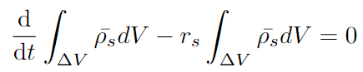
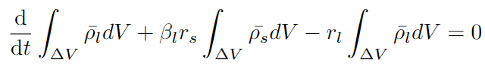
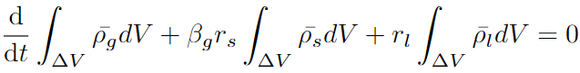
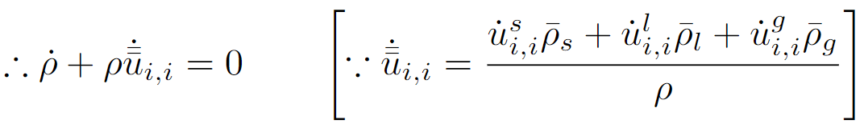
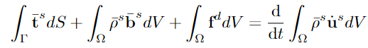
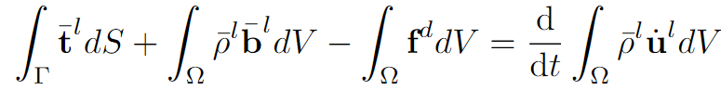
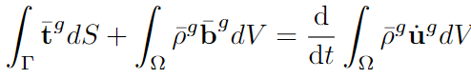
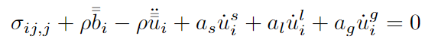
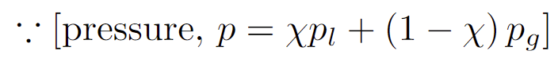
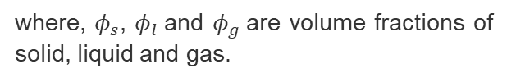
Background
Theory
Numerical Setup
Results and Analysis
Conclusion
Balance Principles for Poroelastic Materials – Full Formulation
Intrinsic and Macroscopic Average Densities
Mass conservation for solid, liquid, gas and mixture, respectively
where, $φ_{s}$, $φ_{l}$and $φ_{g}$are volume fractions of solid, liquid and gas.
Linear Momentum Balance for solid, liquid, gas and mixture, respectively
Intrinsic and Macroscopic Average Stresses
Notes:
A poroelastic material consists of multiple phases, such as solid, liquid, and gas. In their mass conservation and linear momentum balance equations, there are contributions from their average densities, average stresses, and pressures from the fluid phases. For any finite element formulation, we need a discretized weak form. For the poroelastic weak form formulation, we require both the combined mass balance equation and the linear momentum balance equation for the mixture. These balance equations for each phase need to be expressed in their average forms instead of intrinsic forms because multiple phases are present in the poroelastic material, and their volume fractions need to be considered in calculation of density and stresses.

Slide 6
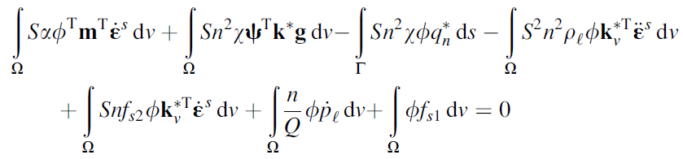
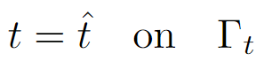
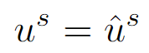
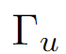
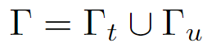
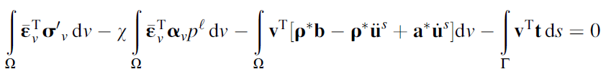
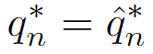
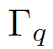
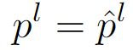
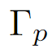
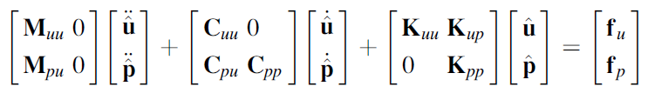
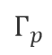

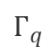
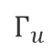
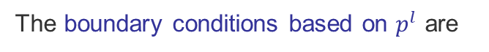
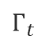
Background
Theory
Numerical Setup
Results and Analysis
Conclusion
Poroelastic Material Model – u-p Formulation
Primary Variable: $u^{s}$ and $p^{l}$
Weak Form of Mass Conservation Equation of Mixture
The boundary conditions based on $u^{s}$ are
on
Solid Skeleton
$$Г_{t}$$
on
$$Г_{u}$$
Weak Form of Linear Momentum Balance Equation of Mixture
where,
The boundary conditions based on $p^{l}$ are
on
$$Г_{q}$$
Finite Element Matrix Equations
Liquid
on
$$Г_{p}$$
where,
[Anandarajah, A. (2011). Computational methods in elasticity and plasticity: solids and porous media. Springer Science & Business Media.]
Notes:
In our poroelastic contact analysis, we consider only the liquid and solid phases, using a two-field formulation. In this formulation, we assume the contributions of gas density, gas pressure, and the acceleration of the liquid phase relative to the gas phase are negligible. We only consider the relative displacement between the liquid and solid phases.
In the two-field formulation, we have two primary variables: solid displacement and fluid pressure and boundary conditions for two of them. Considering all the assumptions, the weak form derived from mass balance and linear momentum balance is as follows. These two weak forms create the element matrix shown here. By solving these equations, we obtain our primary variables.

Slide 7
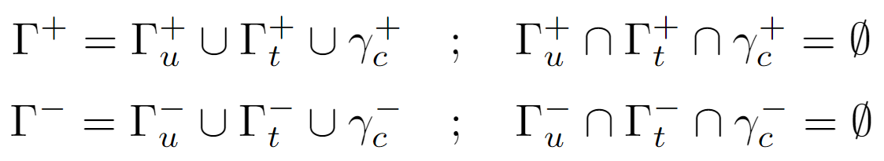
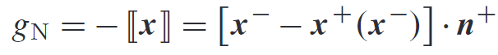
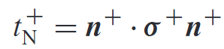
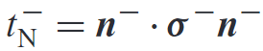
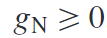
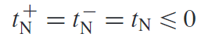
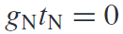
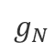
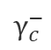
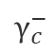
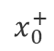
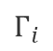
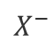
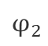



















Background
Theory
Numerical Setup
Results and Analysis
Conclusion
Contact Algorithm
For two separate domains $Ω_{c}^{+}$ and $Ω_{c}^{−}$, the boundaries where contact can potentially happen are $γ_{c}^{+}$and $γ_{c}^{−}$.
$$Г_{u}$$
$$Ω^{−}$$
$$Г_{t}$$
$$n^{+}$$
$$n^{−}$$
$$Г_{u}$$
$$Г_{i}$$
The normal gap function,
$$Ω^{+}$$
$$Г_{t}$$
The contact pressure $p_{N}$ = -$t_{N}=−t.n$ on each surface,
$$φ_{1}$$
$$x^{−}$$
$$γ_{c}^{−}$$
$$g_{N}$$
$$γ_{c}^{−}$$
$$X^{−}$$
$$g$$
$$n^{+}$$
$$γ_{c}^{+}$$
$$X^{+}$$
KKT conditions on $Г_{i}$,
$$φ_{2}$$
$$x_{0}^{+}$$
$$x^{+}$$
;
;
$$γ_{c}^{+}$$
[Masud, A., Truster, T. J., & Bergman, L. A. (2012). A unified formulation for interface coupling and frictional contact modeling with embedded error estimation. International Journal for Numerical Methods in Engineering, 92(2), 141-177.]
[Sauer, R. A. (2016). A survey of computational models for adhesion. The Journal of Adhesion, 92(2), 81-120.]
Notes:
Now, let's dive into the contact-related theories. Consider two separate domains: Ω+\ and Ω−\ −, with two boundaries Γc+\Gamma_ and Γc−\Gamma_cc−​ where contact can potentially occur. The total boundaries of each domain will be the sum of the Dirichlet boundary, Neumann boundary, and potential contact boundary.
The normal gap function represents the displacement jump in the direction of the unit normal onto the projection surface. The pressure is the negative traction in the unit normal direction, and the contact pressure on each surface can be projected using these equations.
The Karush-Kuhn-Tucker (KKT) conditions, or inequality constraints, for contact without penetration on Γi ​ are as follows:
The gap needs to be greater than or equal to zero.
The contact pressure should be less than or equal to zero.

Slide 8























Background
Theory
Numerical Setup
Results and Analysis
Conclusion
Contact Algorithm (Cont’d)
Penalty Formulation
$$φ_{1}$$
$$Ω^{−}$$
$$x^{−}$$
The contact potential energy,
$$Ω^{−}$$
$$γ_{c}^{−}$$
$$g_{N}$$
$$γ_{c}^{−}$$
$$X^{−}$$
$$g$$
$$n^{+}$$
$$γ_{c}^{+}$$
$$X^{+}$$
$$Ω^{+}$$
$$φ_{2}$$
$$Ω^{+}$$
$$x_{0}^{+}$$
$$x^{+}$$
$$γ_{c}^{+}$$
The penalty parameter, ${\text{ϵ}}_{N}>0$
Linearized Penalty Formulation,
The total potential energy,
[Fischer, K. A., & Wriggers, P. (2005). Frictionless 2D contact formulations for finite deformations based on the mortar method. Computational Mechanics, 36, 226-244.]
Notes:
The contact potential energy based on the penalty formulation is expressed in this integral form. To calculate the total potential energy, the contact potential energy must be minimized. For minimization, its variational form is considered, leading to the final linearized penalty formulation

Slide 9








Background
Theory
Numerical Setup
Results and Analysis
Conclusion
Adhesive Contact Algorithm
The local interaction potential between the individual particles of neighboring bodies,
The total potential energy between two interacting bodies,
Integrating forces over tributary volume or area produces body force or traction, respectively:
[Li, S., Sun, B., & Sauer, R. A. (2012). Computational contact formulations for soft body adhesion. Advances in Soft Matter Mechanics, 55-93.]
[https://www.researchgate.net/figure/Schematic-of-the-Lennard-Jones-interatomic-potential-between-two-atoms-or-macro-spheres_fig3_239403055]
Notes:
The adhesive contact between the bodies is described by a global interaction potential Πc\Pi_cΠc​, which is based on the local interactions between the individual particles of the neighboring bodies. The total potential energy of the two interacting bodies is given by the sum of the internal, external, and contact energy. The local potential energy between primary and secondary surface induces force from secondary surface to the surface where we are taking projections I mean the primary surface.

Slide 10








Background
Theory
Numerical Setup
Results and Analysis
Conclusion
Cohesive Adhesion Algorithm
To regularize t_{k} for numerical purposes, a bi-linear reversible traction-separation relation is used:
Traction
t
A
Formula for Adhesion:
t_{c}
; when
Formula for Attraction / Repulsion:
B
C
O
g_{c}
g₀
g
; when
Separation
Formula for Separation:
Normal Work Separation:
; when
Notes:
Similar to the Lennard-Jones potential interaction versus distance curve, we have a traction-separation curve with line equations for different regions. During indentation, the traction force increases, separation g decreases, and attraction occurs. When g decreases further, adhesion occurs between the contacted surfaces. When g starts to increase again, the traction increases due to attraction. After that, when the energy exceeds the critical energy, separation occurs, as demonstrated in the video."

Slide 11
Background
Theory
Numerical Setup
Results and Analysis
Conclusion
Flowchart of Numerical Analysis
Geometry and mesh are imported or created using GeneratedMeshGenerator.
Boundary Conditions are applied.
The solution is verified against analytical result from literature.
Number of timesteps and solving method are chosen depending on analysis.
Finally, the verified model is implemented for further analysis.
Poroelastic material property is assigned from the literature.

Slide 12


Background
Theory
Numerical Setup
Results and Analysis
Conclusion
Why MOOSE
Supports fully coupled or segregated systems
Automatic differentiation (AD)
Unstructured mesh with FEM shapes
Higher order geometry
Mesh adaptivity (refinement and coarsening)
Massively parallel (MPI and threads)
[https://mooseframework.inl.gov/workshop/]
Notes:
We have used MOOSE for our analysis because our analysis is a multiphysics problem involving solid mechanics, contact, and a special poroelasticity material model. MOOSE has the capability to couple multiphysics problems through its kernels. It also has unstructured mesh handling capability and several other advantageous characteristics.

Slide 13



Background
Theory
Numerical Setup
Results and Analysis
Conclusion
Validation of Terzaghi’s Consolidation
Geometry, Material Properties and Boundary Conditions
A linear elastic, saturated soil deposit is subjected to a surface pressure of t_{y} kPa.
t_{y}
The time-variation of t_{y} can be expressed as,
30 m
E (kPa) | υ | n | K_{l} (kPa) | $\overline{k}$ (m⁴/(kN-s))
30 x 10³ | 0.3 | 0.3 | 0.11 x 10⁷ | 0.102 X 10⁻²
7.5 m
[Anandarajah, A. (2011). Computational methods in elasticity and plasticity: solids and porous media. Springer Science & Business Media.]
Notes:
Initially, we considered a fully saturated poroelastic model with geometric, material properties, and boundary conditions similar to those found in the literature. We set up simulation methods using two different finite element frameworks, MOOSE and FEBio, and compared the results with the analytical solutions from the literature to validate that our method of setting up the poroelastic material model is correct.

Slide 14


Background
Theory
Numerical Setup
Results and Analysis
Conclusion
Validation of Terzaghi’s Consolidation (Cont’d)
Contour Plots of Pore Pressure Using Different FE Frameworks
Analytical
Time = 0.05 sec
FEBio
Time = 0.05333 sec
MOOSE
Time = 0.0563135 sec
Notes:
From the contour plot of pore pressure, it can be seen that the results are almost identical to the analytical ones at approximately 0.05 seconds.

Slide 15

Background
Theory
Numerical Setup
Results and Analysis
Conclusion
Validation of Terzaghi’s Consolidation (Cont’d)
Comparison of Pore Pressure Plots Using Different FE Frameworks
Notes:
The graphical plot of pore pressure at the (0,0) point provides clear evidence that the results from the different frameworks are the same.

Slide 16

Background
Theory
Numerical Setup
Results and Analysis
Conclusion
Validation of Terzaghi’s Consolidation with Contact
Geometry, Material Properties and Boundary Conditions
A linear elastic, saturated soil deposit is in contact with a non-porous solid elastic top block. The top block is subjected to a pressure of t_{y} kPa on its surface, which in turn applies pressure to the saturated soil deposit.
t_{y}
7.5 m
The time-variation of t_{y} can be expressed as,
Contact Surface
Top (Solid)
E (kPa) | υ
30 x 10³ | 0.3
30 m
Bottom (Saturated Soil)
E (kPa) | υ | n | K_{l} (kPa) | $\overline{k}$ (m⁴/(kN-s))
30 x 10³ | 0.3 | 0.3 | 0.11 x 10⁷ | 0.102 X 10⁻²
7.5 m
Notes:
Since our goal is to set up poroelastic contact analysis, we extended this validation to include contact between the same poroelastic material and a rigid material. We used the same geometry and material properties for the bottom poroelastic material block and only added a top block to establish contact between the two.

Slide 17


Background
Theory
Numerical Setup
Results and Analysis
Conclusion
Validation of Terzaghi’s Consolidation with Contact (Cont’d)
Contour Plot of Pore Pressure in Contact
Analytical
Time = 0.05 sec
MOOSE
Time = 0.0569474 sec
Notes:
This normal contact simulation also provided results that are almost identical, as evidenced by the contour plots and graphical plots for both the non-contact consolidation problem and the consolidation problem with contact in MOOSE. Coupling of poroelastivity and contact is a new development for the MOOSE community.

Slide 18


Background
Theory
Numerical Setup
Results and Analysis
Conclusion
Contact Analysis Between Poroelastic and Elastic Material
Geometry, Material Properties and Boundary Conditions
y
A saturated poroelastic material is in contact with a non-porous solid elastic top spherical indenter. The indenter is subjected to a piecewise linear displacement boundary condition on its top surface.
The time-variation of displacement y is expressed as:
10 m
3 m
Top (Solid)
Load Curve
E (Pa) | υ
1.0e7 | 0.25
15 m
Bottom (Saturated Poroelastic Material)
E (Pa) | υ | n | K_{l} (Pa) | $\overline{k}$ (m⁴/(N-s))
1.0e7 | 0.25 | 0.3 | 0.11 x 10⁷ | 0.102 X 10⁻²
17 m
Notes:
Now we have changed our geometry and material properties in the same setup because we need to compare our results with experiments and use geometry similar to that in the experiment. This is also a normal contact analysis, but it includes not only indentation but also retraction tests.

Slide 19




Background
Theory
Numerical Setup
Results and Analysis
Conclusion
Contact Analysis Between Poroelastic and Elastic Material (Cont’d)
Reaction force Vs displacement plot for adhesion less poroelastic and solid contact
Reaction force Vs time plot for adhesion less poroelastic and solid contact
Stress Vs time plot for adhesion less poroelastic and solid contact
Pore pressure Vs time plot for adhesion less poroelastic and solid contact
Notes:
At the top left, in can be noticed that the reaction force increases from zero displacement during indentation. During retraction, the reaction force decreases, following a similar trend: it initially decreases and then becomes zero.
The trends of reaction force vs. time and stress vs. time are similar. Both quantities increase up to 0.1 seconds, remain constant from 1 second to 2 seconds, and then decrease during retraction.
The trend of pore pressure is almost similar to the trend observed in the analytical study. However, in this case, the pore pressure drops very quickly.

Slide 20


Background
Theory
Numerical Setup
Results and Analysis
Conclusion
Adhesion Analysis Between Poroelastic and Elastic Material
Geometry, Material Properties and Boundary Conditions
y
A saturated poroelastic material is in adhesion-based contact with a non-porous solid elastic top spherical indenter.
Penalty Parameter | $t_{c}$ (Pa) | $g_{0}$(m)
1.0e8 | 25000 | 0.5
The time-variation of y can be expressed as,
10 m
3 m
Load Curve
Top (Solid)
E (Pa) | υ
1.0e7 | 0.25
15 m
Bottom (Saturated Poroelastic Material)
E (Pa) | υ | n | K_{l} (Pa) | $\overline{k}$ (m⁴/(N-s))
1.0e7 | 0.25 | 0.3 | 0.11 x 10⁷ | 0.102 X 10⁻²
17 m
Notes:
Now we have reached a more interesting point in this presentation. We have added adhesion properties to the same poroelastic contact model.

Slide 21




Background
Theory
Numerical Setup
Results and Analysis
Conclusion
Comparison
Stress Contour at the Timestep before Indentation (Time: 0.6 sec)
Normal Contact
Contact with adhesion
Notes:
At the timestep before indentation, there is no change in the normal contact stress contour. However, higher tensile stress can be noticed near the region where attraction is present due to adhesion.

Slide 22




Background
Theory
Numerical Setup
Results and Analysis
Conclusion
Comparison (Cont’d)
Stress Contour at the Timestep after Separation (Time: 2.6 sec)
Normal Contact
Contact with adhesion
Notes:
Similarly, after separation, tensile stress can still be observed in the same region due to attraction.

Slide 23


Background
Theory
Numerical Setup
Results and Analysis
Conclusion
Comparison (Cont’d)
Comparison plot of Stress Vs time between adhesion-based contact and adhesion less contact
Comparison plot of pore pressure Vs time between adhesion-based contact and adhesion less contact
Indentation
Retraction
Notes:
In the stress plot, in adhesion based contact, tensile stress can be visualized at the beginning of the indentation and after the separation during retraction. In the pore pressure plot, with adhesion, negative pore pressure (i.e., tension) can be observed when indentation starts.

Slide 24


Background
Theory
Numerical Setup
Results and Analysis
Conclusion
Rate Dependent Adhesion Behavior
Comparison plot between 1 sec and 0.25 sec dwelling time for normal contact
Loading Curve for 1 sec dwelling time
Rate Independent
Loading Curve for 0.25 sec dwelling time
Notes:
We considered two different dwelling times, 1 second and 0.25 seconds, to observe the rate-dependent response.
No rate-dependent response can be observed in adhesionless contact.

Slide 25

Background
Theory
Numerical Setup
Results and Analysis
Conclusion
Rate Dependent Adhesion Behavior (Cont’d)
Comparison plot between 1 sec and 0.25 sec dwelling time for adhesion-based contact
Loading Curve for 1 sec dwelling time
Rate Dependent
Loading Curve for 0.25 sec dwelling time
Notes:
Whereas, in adhesion-based contact, a higher holding time results in a steeper increase in tensile stress.

Slide 26
Background
Theory
Numerical Setup
Results and Analysis
Conclusion
Conclusion
The validation of the simplest fully saturated consolidation problem ensures the accuracy of the poroelastic model, which is available in different finite element codes.
The similar outcome from the contact model of the consolidation problem verifies that the physics of poroelasticity and contact can be coupled in MOOSE, although it has not been coupled before.
Adhesion less contact models fail to capture the rate-dependent response of poroelastic materials

Slide 27
Acknowledgement
The authors would like to thank the National Science Foundation for supporting this research (Award No.: 2224371, CMMI-Div Of Civil, Mechanical, & Manufact Inn, Program Director: Lucy T. Zhang)

Slide 28
Thank You

Slide 29
(a)
(b)

Slide 30
(a)
(b)

Slide 31
(a)
(b)
(c)

